Slide 1

YouTube
Transcript Summarizer
GUIDE: DR.S.VIDHUSHA
NANDINI ARIMANDA (22011101076)
VENUPRIYA A (22011101123)

Slide 2
INTRODUCTION:
A YouTube Transcript Summarizer is a tool or system designed to extract and condense the content of YouTube video transcripts, providing users with a concise summary of the video's spoken content.
AIM:
The primary purpose of a YouTube Transcript Summarizer is to make video content more accessible and time-efficient. It helps users quickly understand the key points and information presented in videos without having to watch the entire content.
OBJECTIVES:
Efficient Content Consumption
Accessibility
Enhanced Searchability
Content Promotion
User-Friendly Experience
Enhanced User Experience

Slide 3
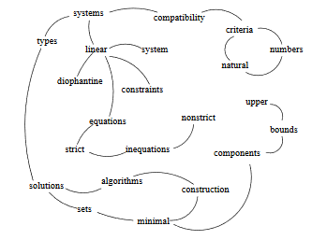
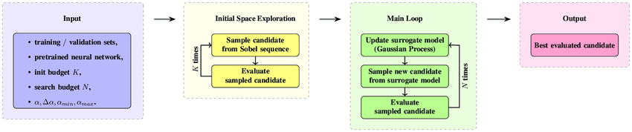
ALGORITHM USED:
TextRank and SingleRank are two algorithms used.
TextRank and SingleRank are both graph-based ranking algorithms for text summarization. TextRank considers sentences as nodes in a graph and ranks them based on their co-occurrence patterns. SingleRank, on the other hand, extends TextRank by incorporating word-level information. It assigns scores to both sentences and words, using word centrality to enhance the ranking process for better summarization results.
TextRank:
SingleRank:

Slide 4
How it works?
The system starts by fetching the video's transcript, which can be provided by the video uploader or generated using automatic speech recognition (ASR).
NLP algorithms process the transcript to identify and extract key information. This may include identifying important sentences, keywords, or phrases.
The summarized content is presented to the user in a readable format, often as a concise text summary or bullet points.
Transcript Retrieval
Text Pre-processing
Natural Language Processing
Text Summarization
Continuous Improvement
User Interface
Summary Presentation
User Customization

Slide 5
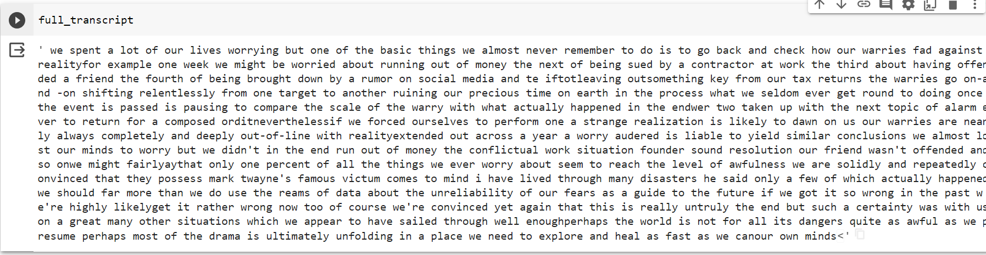
Output:
FULL TRANSCRIPT
SUMMARIZED TRANSCRIPT

Slide 6
Benefits:
Time-Saver: Quickly grasp video content.
Customizable: Tailor summaries to your needs.
Global Reach: Multilingual support for a diverse audience.
User-Friendly: Easy to use and accessible.
Enhanced UX: Makes video content more user-friendly and engaging.
Future Enhancements:
Improved Speech Recognition
Multilingual Summarization
Abstractive Summarization
Customization Enhancements
Real-Time Summarization
USE CASES:
Language Learning
Content Review for Creators
Academic Research
Efficient Information Retrieval
Accessibility for Hearing-Impaired

